Slide 1
Important:
To view this content as a participant in this course would see it, please view in Slide Show mode.
To view this content as an instructor or reviewer, please view in Normal view. Please understand that the slide content will appear differently in Slide Show mode than in Normal view. That is an intentional part of the design of the module.
ATA 24
Notes:
For the purpose of this demonstration, this PPT represents one piece of the instructor-led training (ILT) solution. It includes excerpts from the Electrical ILT source content to demonstrate how an instructor would deliver the content in a classroom to participants. The speaker notes for each slide include three components (as appropriate), two of which would reside in the Instructor Guide, if this were a complete ILT deliverable.
These three components are:
[Instructor Guide content]
*Instructor Guidance: This text is for the instructor to help guide him or her on how to conduct the training, display content, and conduct activities. *Note: For demo purposes, this is an abridged version of the guidance we would provide an instructor in a full-fledge Instructor Guide.
Speaking Points: This is the source content that provides guidance on what the instructor will “say” to explain the content to participants.
[For your consideration during this review]
Recommendations and Rationale: This section is directed to the client as you review the demo. It provides our recommendations including instructional principles and strategies we would employ if this were a complete ILT deliverable. It also provides the rationale behind each recommendation.
In this demonstration, we have included many of the instructional strategies that highlight the value of an ILT. These include but are not limited to:
Arousing curiosity and interest to learn by aligning the goal of this module to the interests and expectations of the audience.
Chunking the content in a manner suited for easy consumption and smooth transition from PPT lecture to SimfinityTM demonstrations (a CAE SimfinityTM icon is used on the screens to indicate when there is a demonstration).
Including a content organizer or “breadcrumbs” to keep participants and the instructor oriented to where they are within the training.
Using group discussions and activities to keep participants engaged and present opportunities for hand-on practice and expert feedback.
Creating Check Your Knowledge (CKY) questions to serve as checkpoints to assess learner retention.
Per the Vendor Demo Requirements document, we did not modify the source content. However, we did perform a copy edit to ensure consistency (For example, capitalization of particular terms: chargers, DC Bus, Battery Buses, AC Bus, AC Power, DC Power, SimfinityTM, battery, etc. and punctuation).

Slide 2
h
What’s in it for you?
Why did you choose this profession?
What is something interesting about yourself?
What do you expect to learn today?
Notes:
Instructor Guidance:
Go around the room and have each participant provide answers to the questions on the screen.
Have a flipchart available to document participant answers to the last question: “What do you expect to learn today?”. You will revisit these expectations during the conclusion of this module.
Speaking Points:
N/A
Recommendations/Rationale:
This exercise is ideal for small group training. It provides participants an opportunity to find common ground by getting to know one another and state their expectations for learning. The instructor can use this exercise to link learner expectations with the module objectives, as well as validate those expectations during the conclusion of the module.
To modify this exercise for larger groups, the instructor can focus on answering the most important question: “What do you expect to learn today?”.

Slide 3
By the end of this module, you will be able to:
Identify the functions of all the system controls on the flight deck
Identify the meaning of all the System Panel Indications on the flight deck
Recognize the layout of the Electrical System
Recognize the Electrical System Synoptics
Describe normal system operation in different phases of flight
Identify the system redundancies in case of Abnormal or Emergency situations
Recall required Handling and Servicing procedures
Recognize the required ready knowledge of the System Limitations
Notes:
Instructor Guidance:
Read the module objectives aloud.
Call out any objectives that map back to any expectations stated by the participants.
Have SimfinityTM prepared to be able to show the Electrical Panels, Schematics, and synoptics. Preferably setup with engines running for normal indications.
Speaking Points:
N/A
Recommendations/Rationale:
The objectives have been modified slightly to make them measureable statements. Based on SME/client consultation, we would further modify the objectives, as appropriate, so that they clearly align with the source content provided. We would also ensure that each topic represented in the outline had an objective that provided the learning goal for that piece of content. In this case, we noticed that Component Location is a topic referenced in the outline, but does not have a supporting objective. If this were a complete ILT deliverable, we would work with the SME/client to pinpoint a learning goal for this topic.

Slide 4
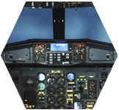
Handling and Servicing
Component Location
Limitations
General
Abnormal/ Emergency System Operations
Normal System Operations
Conclusion
For the purpose of this demonstration, excerpts of the ATA 24 course have been built, including the System Introduction sub-topic and selected content from the System Description sub-topic, specifically DC Power.
Notes:
Instructor Guidance:
This is a graphical representation of the agenda/course outline for this module.
Explain the content of the module.
Speaking Points:
N/A
Recommendations/Rationale:
We built the course agenda to reflect the course outline in its entirety. To meet the 15-20 slide requirement outlined in the Vendor Demo Requirements document, we selected excerpts from the source content including the System Introduction sub-topic and also selected content from the System Description sub-topic, specifically DC Power.

Slide 5
General
General
By the end of this topic, you will be able to:
Identify the functions of all the system controls on the flight deck
Identify the meaning of all the System Panel Indications on the flight deck
Recognize the layout of the Electrical System
Recognize the Electrical System Synoptics
Notes:
Instructor Guidance:
This is a topic separator slide. It introduces the new topic and the objectives for this topic.
Speaking Points:
By the end of this topic, you will be able to:
Identify the functions of all the system controls on the flight deck
Identify the meaning of all the System Panel Indications on the flight deck
Recognize the layout of the Electrical System
Recognize the Electrical System Synoptics
Recommendations/Rationale:
Using a topic separator helps orient participants to what they are about to view and what is expected of them once they have viewed this topic.

Slide 6
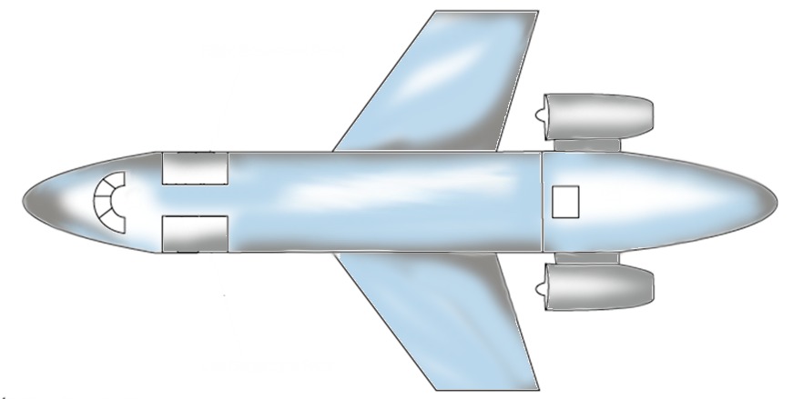
General
System Introduction
System control panels and power sources are located in the cockpit, the galley, and the tail of the aircraft
AC Power
Power Distribution
DC Power
System Controls
Power Distribution
DC Power
AC Power
Notes:
Instructor Guidance:
This slide uses a build to orient participants to where system controls, AC/DC power, and power distribution systems are located on the aircraft.
There are four builds on this slide. Press the Enter key once to reveal each section.
Speaking Points:
N/A
Recommendations/Rationale:
For participants with varying skill sets, it is important to provide an orientation to the aircraft in relation to the content discussed in the first topic. We chose the color red for the arrows for contrast and to draw attention to specific content areas.

Slide 7
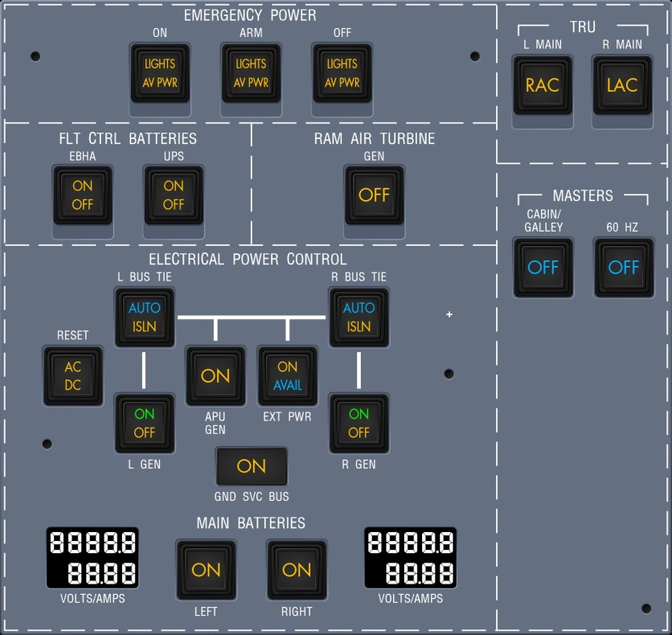
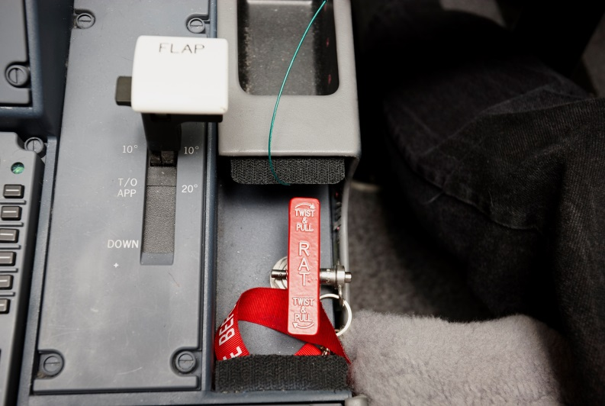
General
System Introduction
System Controls
System controls are managed from the overhead panel and pedestal
Pedestal
Overhead Panel
The icon below indicates that it is time for a CAE SimfinityTM demonstration.
Notes:
Instructor Guidance:
Use the images on this slide to orient participants to where switches and indications are located on the overhead panel, and to where the RAT deploy handle is located.
Press the Enter key once to zoom in on the RAT deploy handle.
Use SimfinityTM to introduce the Overhead Panel switches and Indications to make client familiar with the general layout.
Use SimfinityTM to introduce the Pedestal controls (RAT deploy handle).
Speaking Points:
N/A
Recommendations/Rationale:
This slide provides a quick orientation to what the overhead panel and RAT deploy handle look like. The intent is that the instructor spends a short amount of time on this slide, so that in-class time can be dedicated to the SimfinityTM demo.

Slide 8
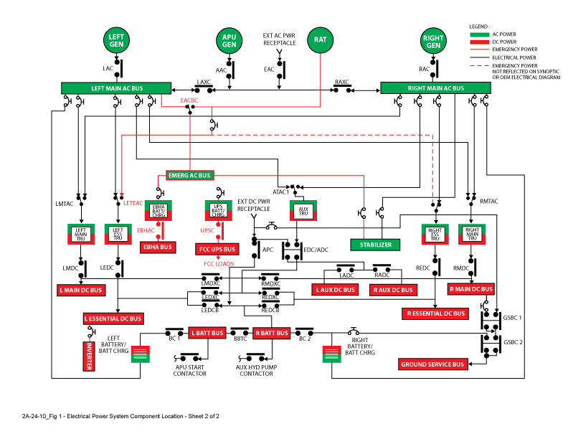
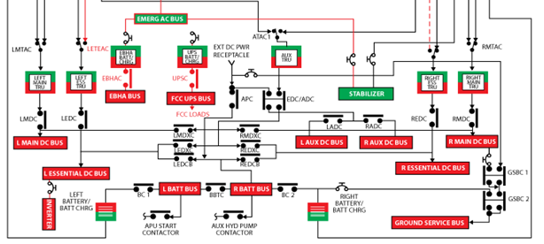
General
System Introduction
System Schematic
The Interactive Electrical Schematic illustrates the electrical sources, buses, and contactors
Power Sources
Main Buses
Buses
AC Power is generated, but most electrical users are powered by DC Buses.
Notes:
Instructor Guidance:
Point out all sources and buses:
Press the Enter key once to zoom in on the power sources.
Press the Enter key once to zoom in on the main buses.
Press the Enter key once to zoom in on the buses.
Use SimfinityTM to present the Interactive Electrical schematic and introduce the overall layout of the system.
Point out that there is no need to remember the name of the contactors in this schematic.
Highlight that we mainly generate AC Power but that most of our electrical users are powered by the DC Buses.
Speaking Points:
N/A
Recommendations/Rationale:
Using the zoom feature, the instructor can quickly point out power sources and buses and dedicate in-class time to the SimfinityTM demo.

Slide 9
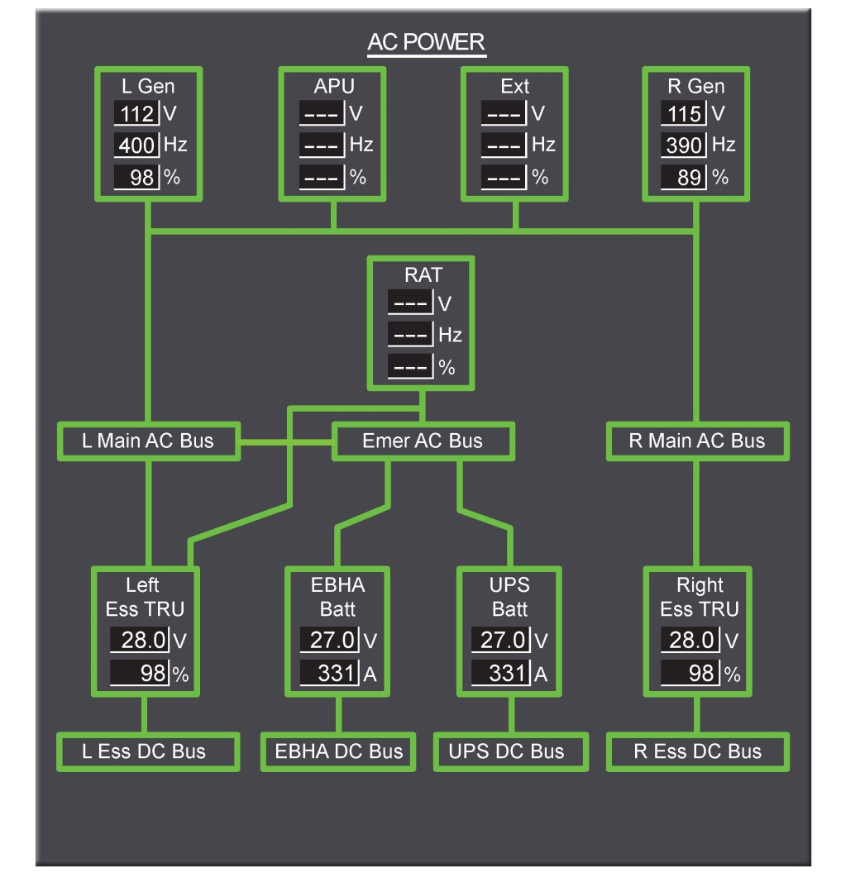
General
System Introduction
System Synoptics
The AC Power synoptic provides a visual representation of system operations and parameters
2/3rd Synoptic – AC Power
Notes:
Instructor Guidance:
Use SimfinityTM to show the different 2/3 synoptics.
Speaking Points:
N/A
Recommendations/Rationale:
N/A

Slide 10
General
System Description
DC Power
Most aircraft systems use DC Power
Placeholder for DC Buses image
Battery Buses do not power any users directly except for the APU Starter and Auxiliary Hydraulic Pump.
A DC Bus will never connect to another opposite DC Bus in order to transfer power.
For the purpose of this demonstration, participants have already viewed the AC Power content and are now focused on the DC Power section of the module.
Notes:
Instructor Guidance:
In the beginning of the electrical discussion, these buses might have been pointed out already. To make the DC discussion more clear, a quick refresher on the DC Buses layout might be necessary.
Highlight what the Battery Buses power. They only power the Aux pump and APU starter directly. The Essential Buses are powered via additional contactors.
To prevent confusion later, it should be emphasized that in the DC system, power is never supplied from one DC Bus to the opposite DC Bus.
Speaking Points:
Most Aircraft Systems will use DC Power.
Left and Right Essential DC Buses have more redundancy than the Left and Right Main DC Buses.
The EBHA Bus and FCC UPS Bus provide power for Primary Flight Controls.
Ground Service Bus is used to power ground servicing equipment even without powering the rest of the aircraft’s buses.
The Auxiliary DC Buses provide DC Cabin and Galley power.
Left and Right Battery Buses can be used to connect the Main Batteries to the rest of the electrical system.
Battery Buses do not power any users directly except for the APU Starter and Auxiliary Hydraulic Pump.
Note: DC system is essentially different in one principle. In the AC systems, a Main AC Bus could be powered from an opposite Main AC Bus. This will never occur in the DC system. A DC Bus will never connect to another opposite DC Bus in order to transfer power.
Recommendations/Rationale:
We included a placeholder for an image of the DC Power system, as it is important to add a visual representation of this system being taught. We also highlighted the key points from the instructor notes directly on the slide.

Slide 11
General
System Description
DC Power
Five Transformer Rectifier Units (TRUs) convert AC to DC Power
Five Transformer Rectifier Units convert AC to DC Power.
Output: nominal 28V, max. 250A (~ 100%).
TRUs are located under the Forward Cabin Floor.
Cooling Fan operation and Temperature are monitored; CAS message will be triggered.
TRU temperatures cannot be read on any synoptic.
Placeholder for TRU images
Notes:
Instructor Guidance:
Discuss the general TRU principles and indications.
Use SimfinityTM to show the TRUs.
Speaking Points:
Five Transformer Rectifier Units convert AC to DC Power.
Output: nominal 28V, max. 250A (~ 100%).
Voltage will vary according to load between 26-29V.
TRUs are located under the Forward Cabin Floor.
TRUs have an internal cooling fan.
Underfloor area is also ventilated/cooled by airflow.
Cooling Fan operation and Temperature are monitored; CAS message will be triggered.
TRU temperatures cannot be read on any synoptic.
Recommendations/Rationale:
For slides 11-13, we split the TRU content across slides and chunked the information in a manner easily facilitated and consumed. On each slide in the TRU section, we highlighted the key points directly on the slide.
With the introduction of the acronym TRU and noticing others throughout the module, we recommend creating a glossary as part of the User Guide for quick reference.

Slide 12
General
System Description
DC Power
DC Power TRUs include main, essential, and auxiliary units
Main TRU
Left and Right Main TRUs powered from respective Main AC Bus.
In case a Main AC Bus fails, the respective Main TRU can be powered from opposite Main AC Bus.
Transfer is not automatic; Crew needs to use respective Main TRU Switch.
Essential TRU
Left and Right Essential TRUs powered from respective Main AC Bus.
In case an Essential TRU fails, the BPCUs will take action.
In case there is no TRU to power an Essential Bus, the Main Batteries will be used.
Placeholder for image of Essential TRU
Auxiliary TRU
Placeholder for image of Auxiliary TRU
Auxiliary TRU normally powered by Left Main AC Bus.
Auxiliary TRU can power only one bus at a time, Priority: Essential over Main and Left over Right.
Notes:
Instructor Guidance:
This slide uses a build to present TRU content. Press the Enter key once to reveal Essential and Auxiliary TRU content.
When discussing Main TRUs:
Use SimfinityTM to point out the possibilities to power the Main TRUs. Use the electrical diagram and the synoptic pages.
Point out the path for the AUX TRU to power a Main DC Bus.
When discussing Essential TRUs:
Use SimfinityTM to show the possibilities to power the Essential TRUs using the electrical schematic and synoptic pages.
Emphasize the redundancy for the Essential DC Buses. Malfunctions will be demonstrated later.
When discussing Auxiliary TRUs:
Use SimfinityTM to show the possible functions of the Auxiliary TRU using the electrical schematic and synoptics.
Malfunctions will be demonstrated later.
Speaking Points:
Main TRUs
Left and Right Main TRUs powered from respective Main AC Bus.
In case a Main AC Bus fails, the respective Main TRU can be powered from opposite Main AC Bus.
Transfer is not automatic; Crew needs to use respective Main TRU Switch.
In case a Main TRU fails, the BPCUs will take action:
The Main TRU will be isolated from its bus.
The Auxiliary TRU will connect to the respective Main AC Bus.
Power is restored after a momentary loss of power Main and Essential TRUs are powered from respective Main AC Bus.
Auxiliary TRU normally powered by Left Main AC Bus.
Essential TRUs
Left and Right Essential TRUs powered from respective Main AC Bus.
In case an Essential TRU fails, the BPCUs will take action:
The Essential TRU will be isolated from its bus.
The Auxiliary TRU will connect to the respective Essential AC Bus.
Power is restored after a momentary loss of power.
In case there is no TRU to power an Essential Bus, the Main Batteries will be used.
Auxiliary TRUs
Auxiliary TRU normally powered by Left Main AC Bus.
Automatic transfer to Right Main AC Bus when Left Main AC Bus fails.
Auxiliary TRU can supply any Essential or Main DC Bus in case a TRU fails.
Single TRU failure will not result in loss of a DC Bus.
Auxiliary TRU can power only one bus at a time, Priority:
Essential over Main
Left over Right
Normally Auxiliary TRU powers the Left and Right Auxiliary Buses.
When Auxiliary TRU powers any Essential or Main DC Bus, the power to the Auxiliary Buses is removed.
Recommendations/Rationale:
On this slide, we chunked the information about the three types of TRUs on one slide for easy reference and consumption – again focusing on giving the instructor in-class time to focus on the SimfinityTM demonstrations. This slide uses a build so that the instructor has a smooth transition from PPT lecture to demo.

Slide 13
General
System Description
DC Power
TRUs activate when there is a loss of power to the main AC Bus, or when AC Power is lost completely
Loss of a single Main AC Bus:
Loss of all AC Power:
Both respective Main and Essential TRUs fail.
Associated Main DC Bus is lost until manually recovered.
Associated Essential DC Bus will be powered by Auxiliary TRU.
Essential Buses initially powered from Main Batteries
When RAT is deployed, both Essential TRUs will be powered again directly from the RAT.
Main Batteries will not be required anymore.
Notes:
Instructor Guidance:
Press the Enter key once to reveal “Loss of all AC Power” content.
Speaking Points:
Summary: Loss of a single Main AC Bus:
Both respective Main and Essential TRUs fail.
Associated Main DC Bus is lost until manually recovered.
Associated Essential DC Bus will be powered by Auxiliary TRU.
Note: Auxiliary TRU can power only one bus at a time.
In case of loss of all AC Power:
Essential Buses initially powered from Main Batteries.
When RAT is deployed, both Essential TRUs will be powered again directly from the RAT.
Main Batteries will not be required anymore.
Recommendations/Rationale:
This content was chunked and extracted from the main TRU content to highlight specifically what to do if there is a loss of power. We used a PPT build to reduce the cognitive load and focus the participants’ attention to one piece of content at a time.

Slide 14
Which part of the Electrical System schematic is highlighted in this image?
Main DC Buses
AC Buses
Power Sources
Auxiliary Buses
Notes:
Instructor Guidance:
This slide uses a build to present the question and reveal the correct answer.
Read the question aloud and ask for/choose a volunteer to provide an answer to the group.
Press the Enter key once to reveal the correct answer.
Speaking Points:
The correct answer is C.
Recommendations/Rationale:
This CYK question is aligned with the objective: “Recognize the layout of the Electrical System.”
If this were a complete ILT deliverable, we would provide descriptive feedback.
Per the Vendor Demo Requirements document, we only included one knowledge check in this demonstration. If this were a complete ILT, we would develop at least one knowledge check and/or activity per learning objective.

Slide 15
General
System Description
DC Power
The tail compartment of the aircraft houses the left and right Main Batteries, including the chargers
Main Batteries used for:
Essential power during Aircraft Pre-flight Power up
APU Start
Essential power in case of loss of all Main AC Power
Ground Service Bus power (right battery only)
Battery Charger uses AC Power from respective Main AC Bus to create DC. Chargers only work when there is AC Power.
Battery Charger can operate in 2 modes:
Charge mode: When battery is not in use, the charger will control the Voltage to have a proper charge of the battery.
TRU Mode: When battery is in use, the charger supplies up to 40 Amps to assist the battery.
Notes:
Instructor Guidance:
This slide uses a build to discuss the key points about Main Batteries:
Press the Enter key once to reveal a close-up of the Main Battery and related key points.
Press the Enter key twice to reveal content related to battery chargers.
Use SimfinityTM to show the Main Batteries and their associated chargers.
Use SimfinityTM to show Battery switches and indications. Show indications on overhead panel and synoptics.
Emphasize that the chargers only work when there is AC Power.
Demonstrate the Charger TRU mode by selecting the AUX Pump on when AC Power is available. The Battery Switch lights will come on, but there is no drain on the batteries since the chargers supply enough power for the electrical AUX Pump.
Speaking Points:
Left and Right Main Batteries, NiCad. Output: nominal 28V, 53Amp/Hour Voltage will vary depending on charge and load.
Battery has dedicated Battery Charger.
Batteries and chargers located in Tail Compartment.
Battery Charger uses AC Power from respective Main AC Bus to create DC. (TRU with charge control function)
Battery Charger can operate in 2 modes:
Charge mode When battery is not in use, the charger will control the Voltage to have a proper charge of the battery.
TRU Mode When battery is in use, the charger supplies up to 40 Amps to assist the battery.
Battery temperature is monitored. CAS Message when battery is warm/hot. Battery temperature is not indicated anywhere.
Main Batteries used for:
Essential power during Aircraft Pre-flight Power up
APU Start
Essential power in case of loss of all Main AC Power
Ground Service Bus power (right battery only)
Batteries can provide Essential power for a period of 16 minutes (includes 2 APU start attempts).
Individual Battery Switch allows Crew to control the Battery Power.
The On legend will only show when the respective battery is in use.
Battery Amps are indicated on the Overhead Panel and Synoptic pages.
A discharge will be indicated by a Minus sign.
Recommendations/Rationale:
On this slide, we used the overhead panel as an anchor to show where the Main Battery switches are located. If this were a complete ILT deliverable, we would work with a graphic artist (GA) to modify the images so that the indications match on both images. The key points about Main Batteries are shown directly on the slide.

Slide 16
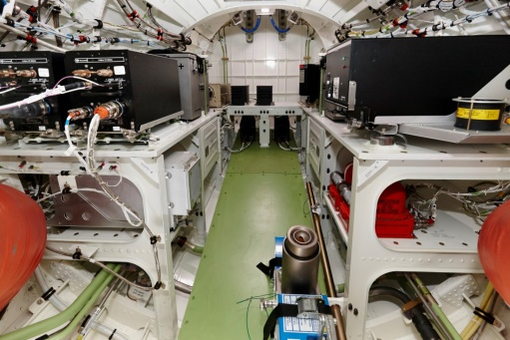
Where are the batteries located in this image?
Forward
Tail Compartment
Notes:
Instructor Guidance:
This activity provides participants an opportunity to use what they have learned thus far to practice locating batteries on an aircraft.
Divide the class into groups for this activity.
Explain aloud the 4-Ps of this activity: purpose, process, participation, and product.
Speaking Points:
The purpose of this activity is to see if you can locate the batteries in the tail compartment of the aircraft. For this activity, we will divide the class into groups.
In your groups, study the image on the slide and identify where the batteries are located.
Once your team has your answers ready, choose one person who will serve as the spokesperson for the group.
By the time you complete this activity, you should be able to identify where batteries are located on an aircraft.
Note: The red arrow indicates which direction is forward.
Recommendations/Rationale:
We chose this activity to provide participants an opportunity to practice what they just learned about batteries. We used the “4-P” activity structure to describe the activity to participants.

Slide 17
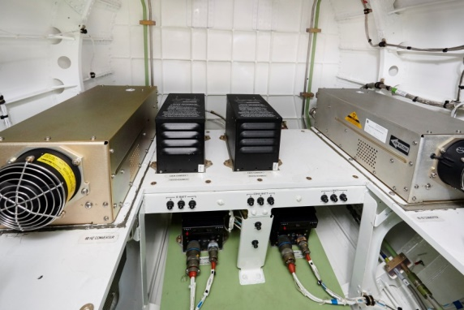
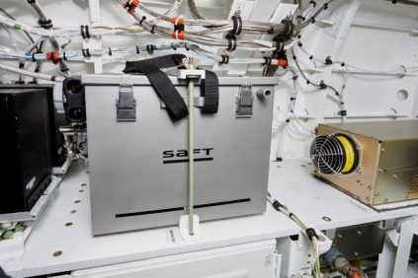
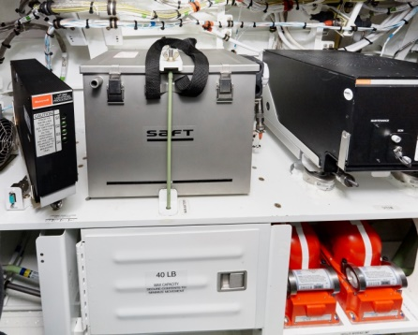
General
System Description
DC Power
Battery and Charger Locations
Left/Right Main Battery Chargers
Right Main Battery
Left Main Battery
Right Main Battery
Left Main Battery
A
A
B
C
C
Tail Compartment
Notes:
Instructor Guidance:
This slide uses a build to identify battery locations in the tail compartment.
Press the Enter key once to reveal the right and left Main Batteries.
Press the Enter key once to reveal the left/right Main Battery chargers.
Press the Enter key once to show the full image with all battery/charger locations shown.
Speaking Points:
N/A
Recommendations/Rationale:
We chose this build so that the instructor can quickly and easily debrief on the previous activity and point out exactly where each battery/charger is located.

Slide 18
What is one thing about the electrical systems on an aircraft that you didn’t know before today?
Where are system controls managed?
How are TRUs powered?
Where are the batteries on an aircraft located?
Notes:
Instructor Guidance:
Use this slide to recap what participants learned during this module.
Read each question aloud and ask for/choose a volunteer to provide a response.
Tie the responses to the question “What is one thing about the electrical systems on an aircraft that you didn’t know before today?” back to learner expectations that were documented at the beginning of this module.
Speaking Points:
What is one thing about the electrical systems on an aircraft that you didn’t know before today?
Where are system controls managed?
Where are the batteries on an aircraft located?
How are TRUs powered?
Recommendations/Rationale:
To close out the module, we developed a series of content-related questions that will help participants reflect on what they learned. If this were a complete ILT deliverable, we would supplement this closing activity by showing the key takeaways for the module. Each key takeaway would align to a learning objective.

